Slide 1
Advanced WebDriver

Slide 2
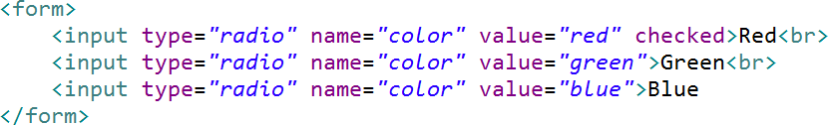
Radio Buttons

Slide 3
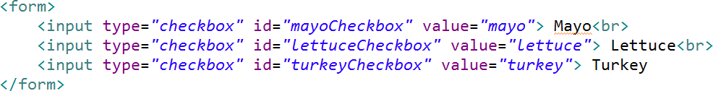
Checkboxes

Slide 4
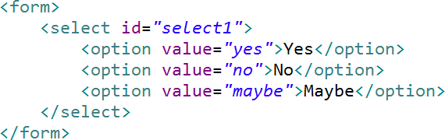
Select Items

Slide 5
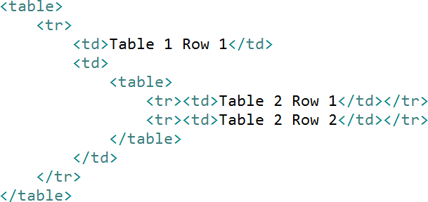
Tables

Slide 6

Waiting
<a href=“...”/>

Slide 7

Radio Buttons
Checkboxes Select Items
Summary
Tables / Nested Tables
XPath
Explicit Waits VS Implicit Waits

